Slide 1

Tree-O-Vision
India Tree Coverage Dashboard
A data-driven web platform for visualizing forest density and identifying
plantation priorities across Indian states
React + TypeScript
Leaflet Maps
Recharts
ISFR Data

Slide 2



The Problem
Forest data exists — but it isn’t usable
Buried in static reports
WHY IT MATTERS
India’s State of Forest Report (ISFR) publishes rich state-wise data, but it sits in long PDFs — not something a planner, student, or citizen can quickly query or compare.
~24%
of India’s geographical area is under forest & tree cover — a number that shifts every ISFR cycle and needs constant monitoring
No fast way to compare states
Officials and researchers need to see, at a glance, which states are gaining forest cover and which are losing it — today that means manually cross-referencing tables.
28+
No link from data to action
states & UTs whose progress needs to be tracked, compared, and acted on individually
Knowing a state’s forest density doesn’t tell you what to plant, where, or why. Reports rarely translate into concrete plantation guidance.
Goal: turn a static government report into an interactive decision-support tool.

Slide 3
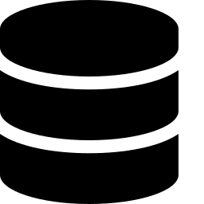



The Solution
An interactive dashboard that turns ISFR data into insight and action
1
2
3
4
Structured Data
Visual Exploration
Automated Insight
Actionable Output
→
→
→
State-wise forest density, cover type, and year-on-year change modeled from ISFR estimates
An interactive India map lets any state be selected, filtered by density, or searched by name
The dashboard surfaces trends, top/bottom performers, and pattern summaries automatically
State-specific plantation suggestions and an exportable report turn insight into next steps
Unlike a generic BI dashboard, every view here is purpose-built for one domain — forest cover — so filters, charts, and recommendations speak the language of foresters and policy planners, not generic "data analysts."

Slide 4
Objective
🌳 Visualize tree coverage and forest density across different states of India.
📊 Analyze tree distribution using interactive maps, charts, and data analytics.
👥 Estimate tree requirements based on population and calculate the tree deficit.
🌱 Identify regions that require priority plantation for sustainable afforestation.
🌍 Support data-driven environmental planning for government agencies, NGOs, and researchers.

Slide 5



Key Features
Every module maps directly to a component in the codebase
Interactive India Map
Smart Filters & Search
Comparative Charts
Click-to-explore state map (IndiaMap.tsx) that opens a detailed state view (StateDetail.tsx) on selection
Filter states by forest-density range or search by name (Filters.tsx), instantly narrowing the map and charts
Top/Bottom-states bar charts, a forest-type pie chart, and a year-on-year growth line chart (Charts.tsx, via Recharts)
Auto-generated Insights
Plantation Suggestions
Downloadable Report
An insights panel (InsightsPanel.tsx) that summarizes patterns in the currently filtered data
Context-aware planting recommendations (PlantationSuggestions.tsx) tailored to the selected state
One-click export (DownloadReport.tsx) so findings can be shared outside the dashboard

Slide 6



Trees Required by Population
A new module that turns a population figure into a concrete plantation target
Population-Weighted Target
HOW IT'S CALCULATED
Each state's population is combined with its current forest density to estimate how many additional trees are needed to reach a healthy per-capita green cover.
1:1
illustrative tree-per-person benchmark used as the module's default target ratio — configurable per state
Transparent Formula
Target trees = Population × per-capita benchmark, minus the tree-cover the state already has — recalculated instantly as filters change.
Pop × Ratio
Concrete Planting Target
population multiplied by the per-capita ratio, minus existing cover, gives the state's tree shortfall
Every state — and eventually every district — gets its own recommended planting number, so plantation drives can be prioritised where the shortfall is greatest.
Goal: convert a population figure into a defensible, state-specific plantation target.

Slide 7


Tech Stack & Architecture
A component-based single-page application, deployed on Vercel
Application Layer
WHY THIS STACK
React 18 + TypeScript — component-driven UI (Index.tsx orchestrates all modules)
Component reuse: each chart/panel is an independent, testable unit
Presentation Layer
Tailwind CSS utility classes + shadcn/ui component primitives for consistent, responsive styling
Leaflet + Recharts are lightweight, no heavy GIS server needed
Visualization Layer
Tailwind + shadcn keep the UI consistent without a custom design system
Leaflet for the interactive state map · Recharts for bar / pie / line charts · Lucide for iconography
Vercel gives instant, zero-config deployment for a live demo
Data Layer
State-wise forest density & cover-type figures modeled on India State of Forest Report (ISFR) estimates

Slide 8
🌍 Sustainable Development Goals (SDGs)
A component-based single-page application, deployed on Vercel
🎯 SDG 13 – Climate Action
🌱 Promotes data-driven afforestation planning.
📍 Identifies tree-deficit regions for targeted plantation.
🌍 Supports climate resilience and forest conservation.
🌳 SDG 15 – Life on Land
🌲 Encourages conservation and restoration of forest ecosystems.
🗺️ Visualizes forest resources and plantation priorities.
🌿 Supports biodiversity and sustainable forest management.
🏙️ SDG 11 – Sustainable Cities & Communities
👥 Estimates tree requirements based on population.
🌳 Helps improve urban green infrastructure.
🌬️ Contributes to better air quality, reduced heat islands, and healthier communities.

Slide 9
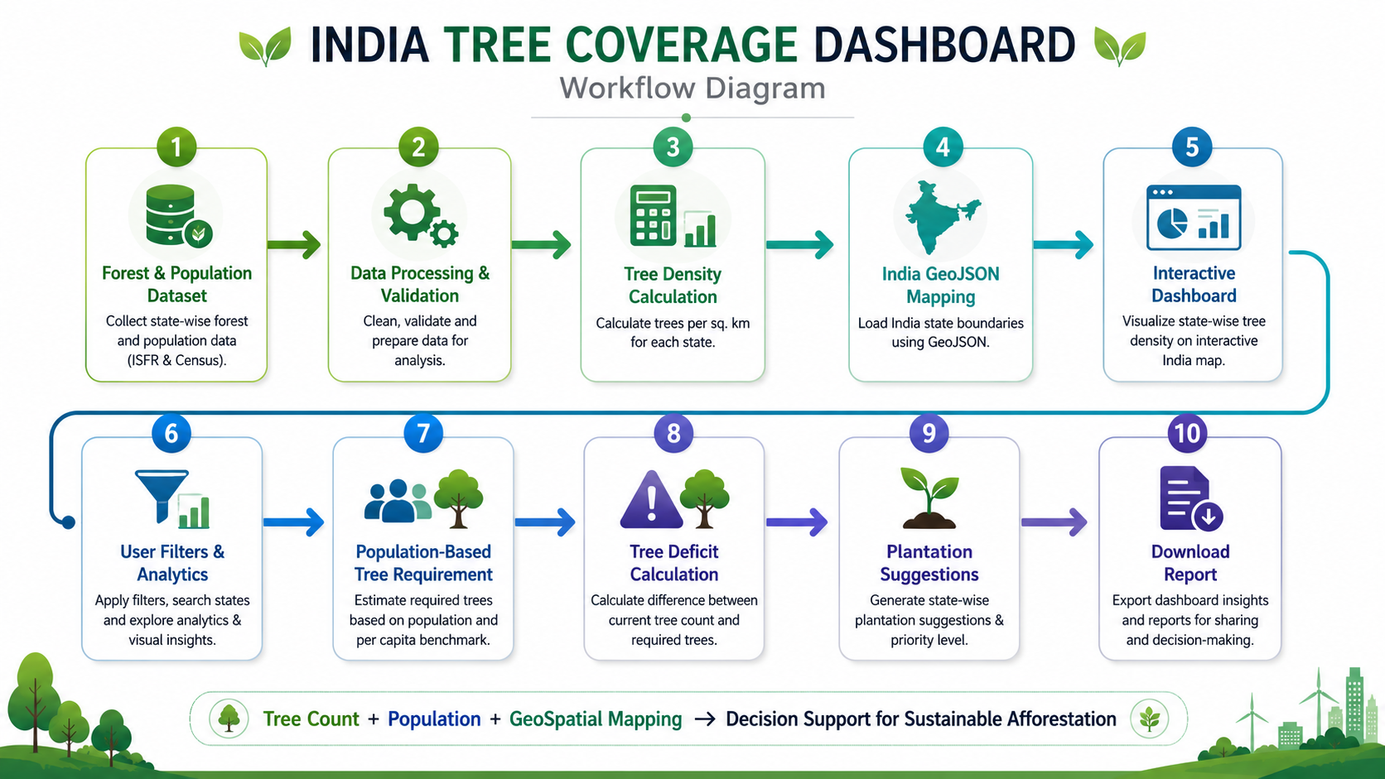

Slide 10
Impact & Conclusion
From a static government report to a living decision-support tool
Climate Action
Life on Land
Tracking forest cover trends supports climate-mitigation planning at the state level
Identifying low-density states enables targeted afforestation to protect ecosystems
WHAT MAKES IT MORE THAN A CRUD APP
Geospatial visualization (Leaflet) combined with multi-chart comparative analytics (Recharts) in one synchronized view
Filter/search state drives the map, charts, and recommendations simultaneously — a real cross-component data flow, not isolated pages
Turns raw government statistics into a decision-support tool with actionable, state-specific plantation guidance
Live demo: software-project-azure.vercel.app

Slide 11
THANK YOU

